Slide 2
Dependent Task Offloading for Edge Computing based on Deep Reinforcement Learning
Report
Presented By: 李昀哲 20123101
Novevmber 1, 2023
Notes:
有些local 有些需要扔到云端

Slide 3

Introduction
Demand Large Computing Resources
Example: AR - Modeling from current enviornment
Service latency (CPU speed)
Energy consupmtion (computation & transmission cost)
Video Resources
Renderer
Object Identifier
Tracker
Mapper
Notes:
有些local 有些需要扔到云端

Slide 4

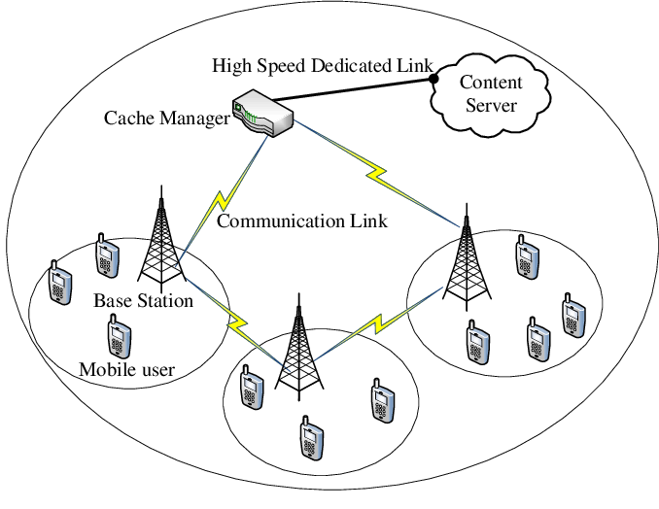
Introduction
Solutions
Cloud ×
Multi-access Edge Computing ✔
long distance

Slide 5
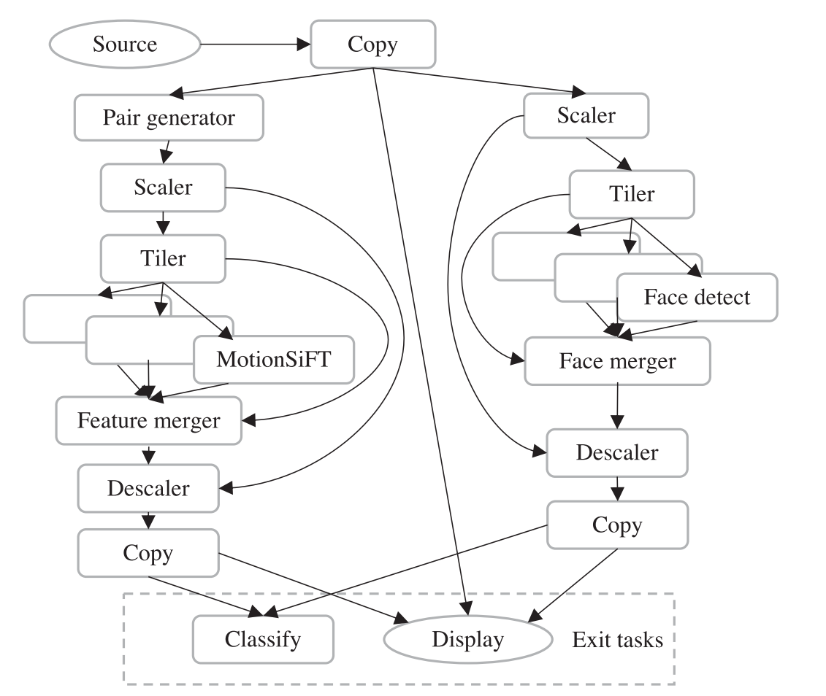
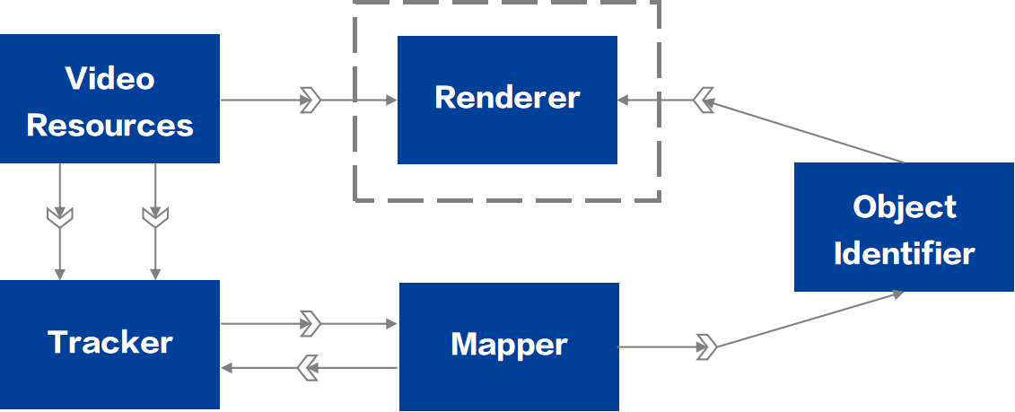
Introduction
Multi-access Edge Computing
Task offloading
CPU Cycles
data size
NP-Hard
Deep Reinforcement Learing

Slide 6
Introduction
Deep Reinforcement Learning
Mapping from env states to action -> maximize rewards
Offloading Task
Outputs
Existing DRL:
Assumed independent
waste resource
Offloading Task
Inputs
Notes:
DRL
learns an effective policy (i.e., a mapping from environment states to actions) through interacting with the environment so as to maximize numerical rewards. With the help of the powerful representation ability of DNNs, DRL can effec_x0002_tively solve complex decision-making problems with large and high-dimensional state/action spaces

Slide 7
Introduction
Need for large computing rescources
Transfer tasks to
the cloud
Long distance between user and the cloud
Transfer tasks to MEC hosts at network edge
Ignore tasks’instrinsic dependencies
Apply Deep Reinforcement Learning
Algorithms heavily rely on expert knowledge
Propose
DRL-based Task Offloading

Slide 8
DRL-based Task Offloading
Example: AR - Modeling from current enviornment
Service latency (CPU speed)
Energy consupmtion (computation & transmission cost)
Edges: Dependency
Vertices: Tasks
Local Executing or Remote Offloading
Notes:
为了解决传统DRL的问题，提出了DRLTO，在介绍他到底做了什么之前，我们再来回顾一下需要解决什么问题

Slide 9
DRL-based Task Offloading
Direct Acycle Graph
Notes:
它是指把一个维数为所有词的数量的高维空间嵌入到一个维数低得多的连续向量空间中，每个单词或词组被映射为实数域上的向量

Slide 10
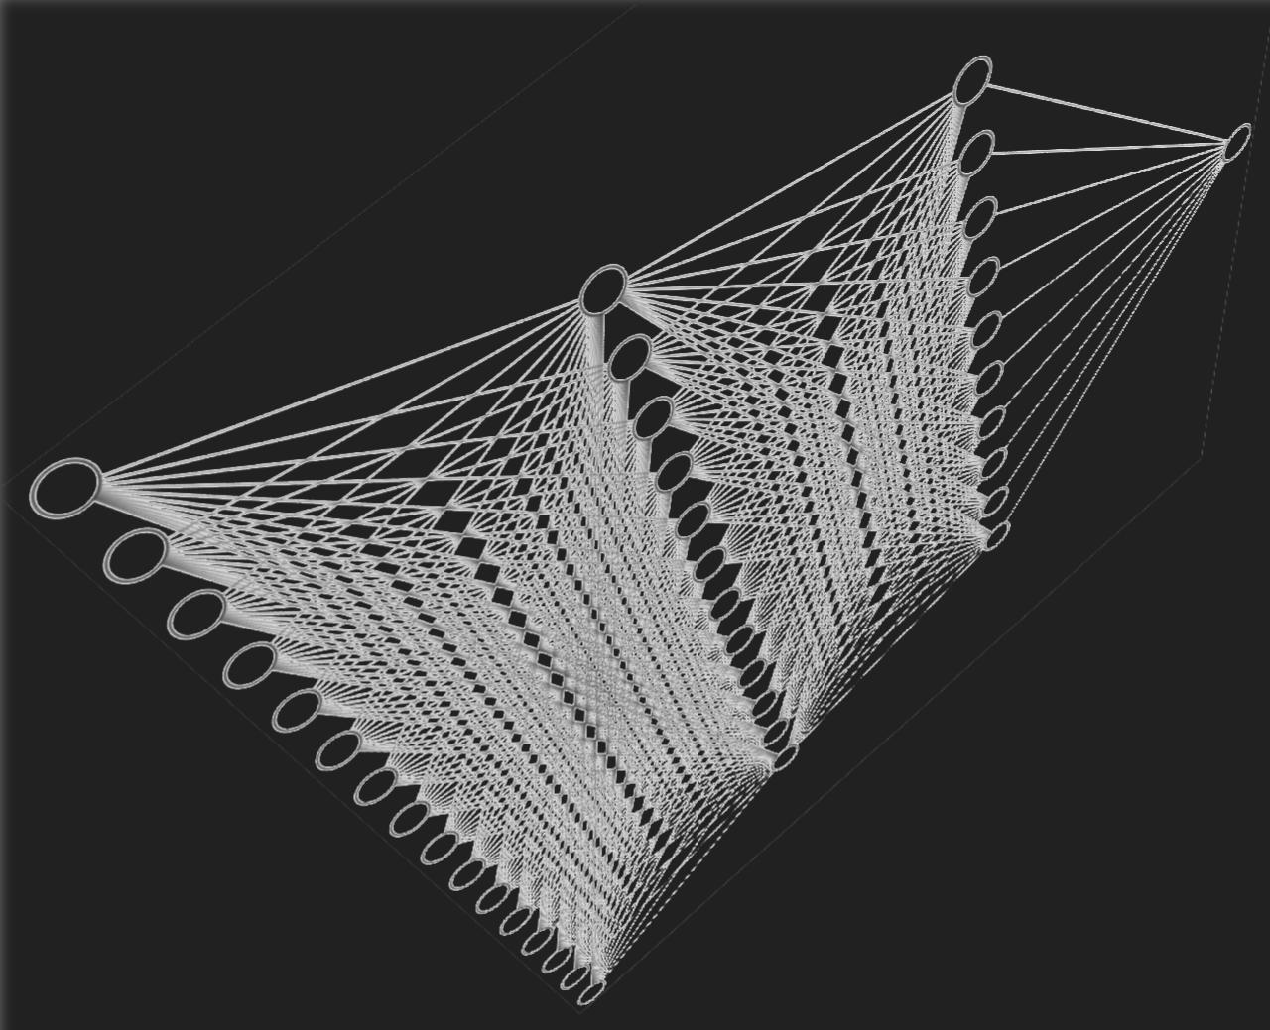
DRL-based Task Offloading
Raw DAG -> sequence of embeddings
task profiles
dependency information
Notes:
它是指把一个维数为所有词的数量的高维空间嵌入到一个维数低得多的连续向量空间中，每个单词或词组被映射为实数域上的向量

Slide 11
DRL-based Task Offloading
Offloading Problem = Markov Decision Process
Embedding vectors
policy
S2S Neural Network
Task Dependency
value function
DRL
Offloading Plan
Example: AR - Modeling from current enviornment
Service latency
Energy consupmtion
Notes:
综合考量latency and consumption 进行offloading plan选择
根据当前状态决策下个动作，不断训练，获得最大的reward

Slide 12
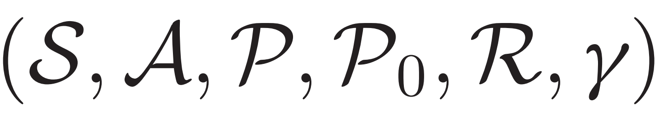
DRLTO Scheme - Background
Reinforcement Learning - MDP
 | Value-based | Policy-based
Feature | optimal value function | directly parameterizes the policy
Updating Rule | one step updating rule | Perform gradient ascent on the total
Drawbacks | slow learning process | get stuck in local optima
 |  | high variance using Monte-Carlo
Generalized Advantage Estimation
Reduce variance
entropy bonus
Enhance the exploration Alleviating local minima
off-policy clipped surrogate objective
stabilize the training
Notes:
- It balances the trade-off between bias and variance by considering both immediate and expected future rewards.
- Using a specific objective function that considers the advantages of actions, constraints for policy updates, and the ability to learn from off-policy data
off-policy: This flexibility is useful for reusing data or optimizing policies without continually collecting new data
clipped ...: there are constraints applied to this surrogate objective to ensure that the policy updates are not too drastic
- It is a regularization technique that's often used in combination with policy gradient methods

Slide 13
DRLTO Scheme - Background
Sequece-To-Sequence Neural Network
A encouder + a decoder implemented by muti-layer RNNs
+ attention mechanism
Attend more important information from the input
Notes:
at each decoding step, a decoder output depends on its previous output, previous hidden state, and a context vector which is a weighted sum of the encoder output. Introducing the context vector gives the decoder a chance to “attend” important information from the source input sequence
They are particularly valuable when dealing with variable-length sequences and tasks that involve understanding and generating human language or other types of sequential data.
A combinatorial optimization problem is a type of mathematical problem in which the goal is to find the best solution from a finite set of possible solutions. In these problems, the solutions are typically composed of a combination or arrangement of discrete elements or objects, and the objective is to optimize a certain criterion, such as minimizing or maximizing a cost, value, or some other measure.

Slide 14
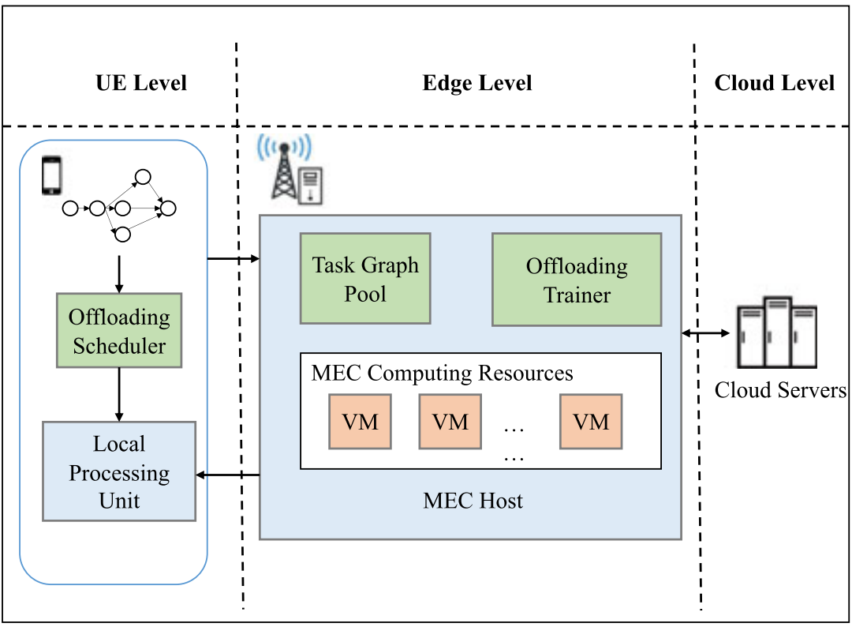
DRLTO Scheme - Design
Gather DAG
Train (at mid-night)
Trained S2S Neural Network

Slide 15

DRLTO Scheme - Taks Offloading Model
State Space: Combination of DAG & partial offload plans

Slide 16
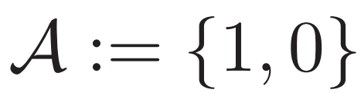
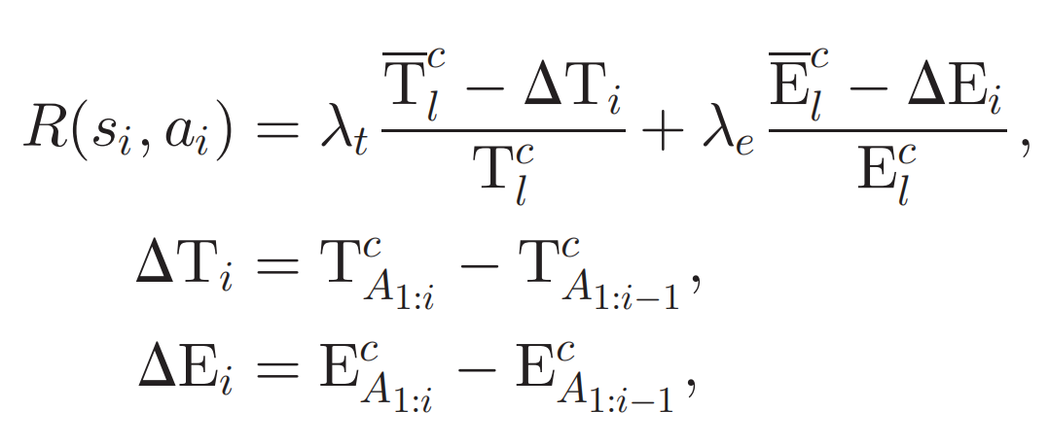
DRLTO Scheme - Taks Offloading Model
Action Space: Run locally or Offload
Reward Function: Maximize Quality of Service
Example: AR - Modeling from current enviornment
Service latency
Energy consupmtion

Slide 17
DRLTO Scheme - S2S Neural Network
The shared parameters in the S2S architecture are used to extract common features in DAGs, therefore training the policy neural network that can accelerate the training of the value neural network and vice versa
WHY?
- Shared knowledge { environment, state transitions, optimal actions}
Both networks benefit from this shared knowledge
- Transfer Learning：
What one network learns about the environment can be transferred to the other

Slide 18
DRLTO Scheme - Training Process
Find an optimal policy
Proximal Policy Optimization
Avoid large update - Clipped target function
+ Entropy bonus
Ensure efficient expolration
Alleviate local optim
Exploitation stage
SGD&Adam for optimization
Notes:
penalizes changes to the policy via a clip function
control clip range

Slide 19

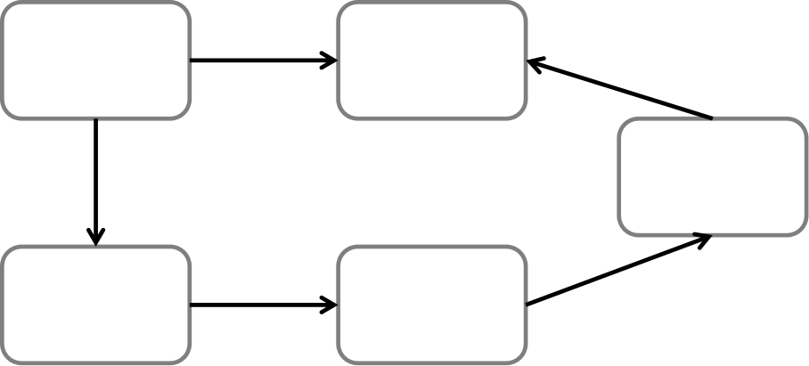


Experiments
Simulation environments & hyperparameters
Transmission rates {3Mbps, 7Mbps, 11Mbps, 15Mbps, 19Mbps}
Synthetic DAGs ( controlled height and width ) {0.3, 0.4, ..., 0.8}
Data size 5KB - 50KB
Task number 10-50 ( step size 5 )
Training
500 Graphs
Testing
100 Graphs

Slide 20
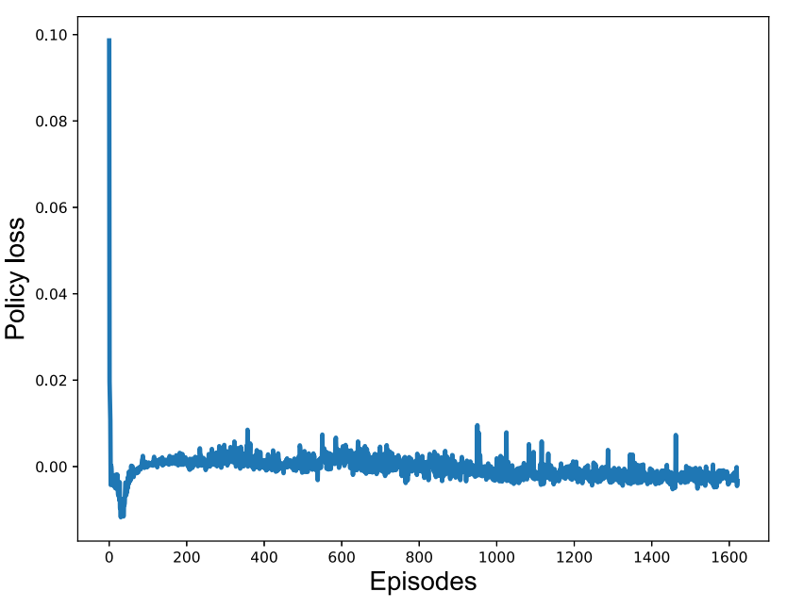
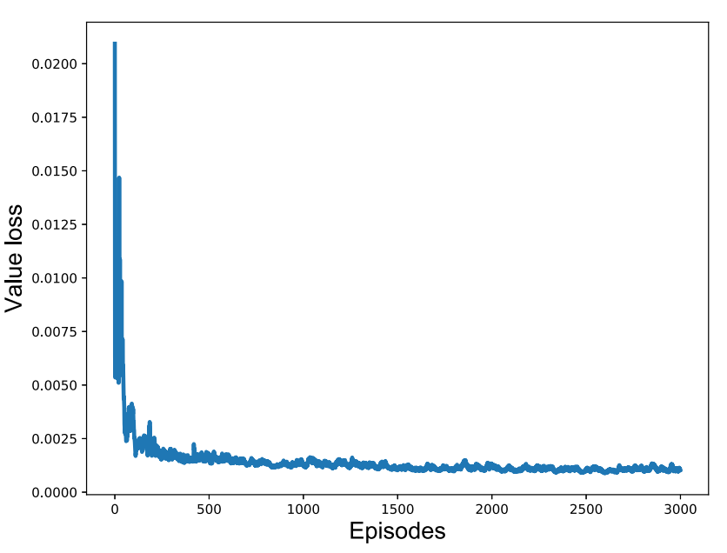
Experiments
Training Performance & Convergence
Targets | Aim | λt | λe
Latency-Optimal | minimize the latency | 1 | 0
Energy-Efficient | jointly optimize the latency & energy consumption | 0.5 | 0.5

Slide 21
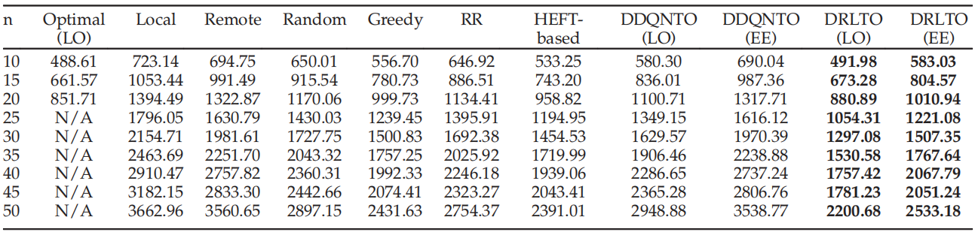
Experiments
Evalution with different task numbers
fix the transmission rate at 7 Mbps
Notes:
both the value loss and the policy loss approximate to zero after 500 episodes

Slide 22
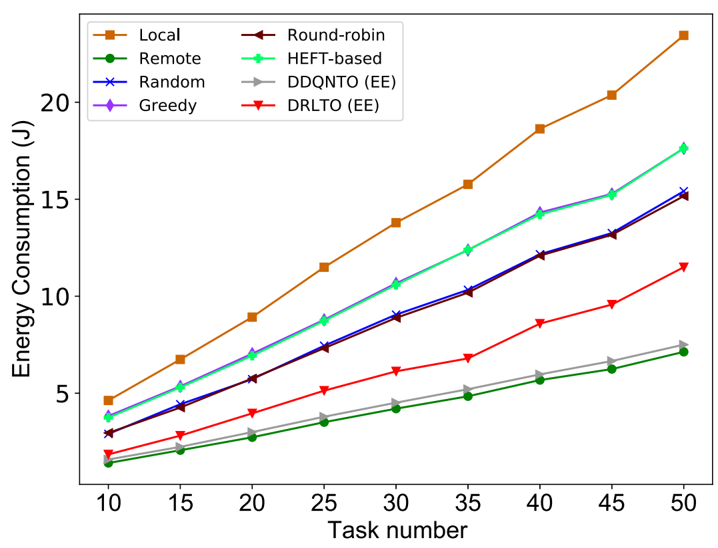
Experiments
Evalution with different task numbers
fix the transmission rate at 7 Mbps
Notes:
both the value loss and the policy loss approximate to zero after 500 episodes

Slide 23
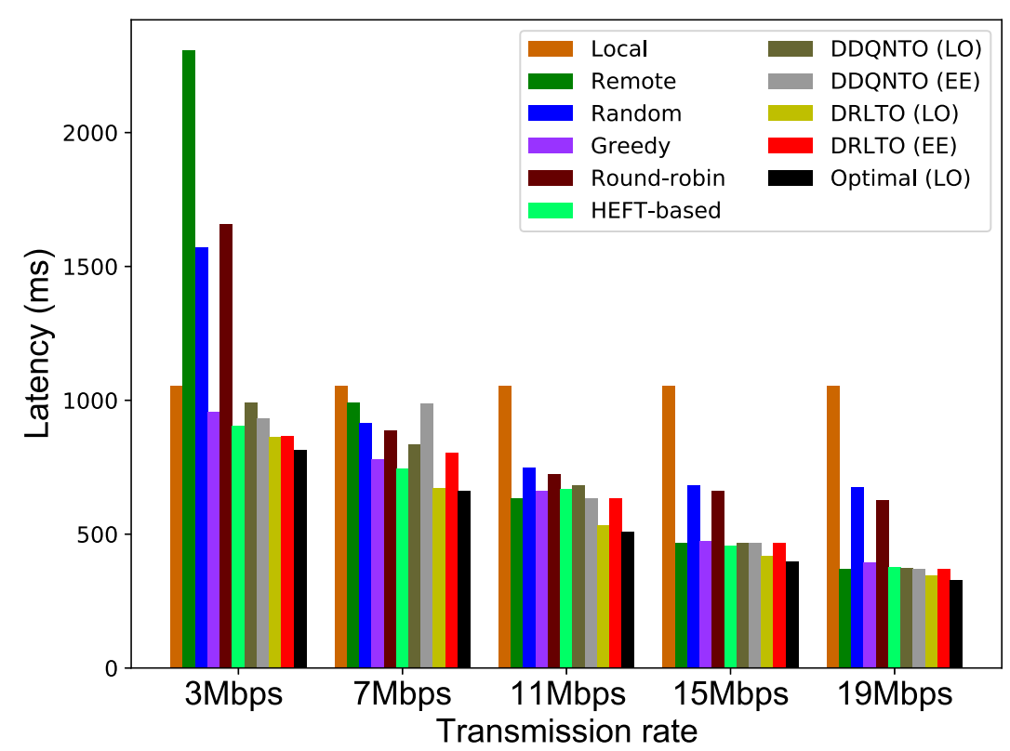
Experiments
Evalution with different Transmission Rates
Notes:
both the value loss and the policy loss approximate to zero after 500 episodes

Slide 24
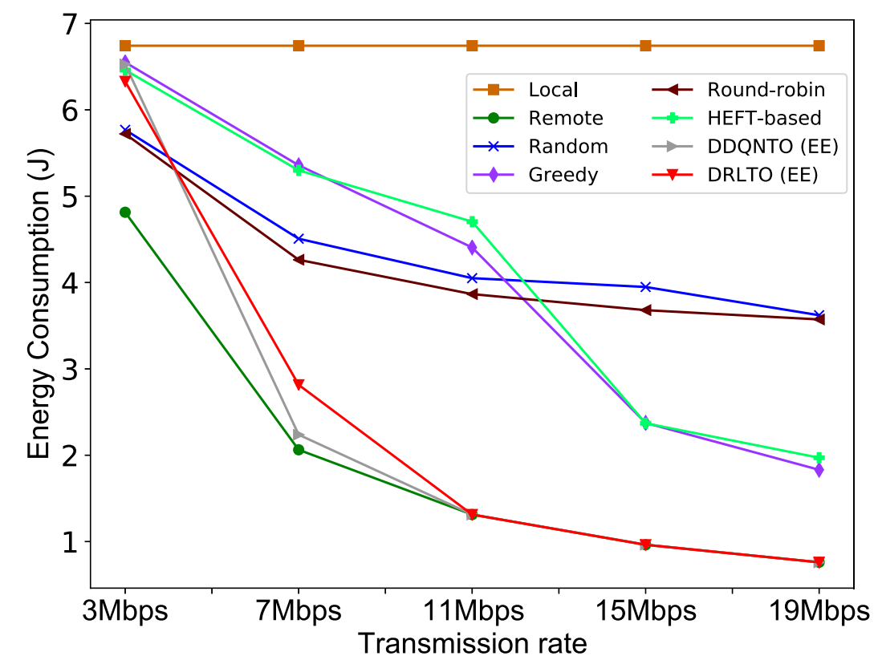
Experiments
Evalution with different Transmission Rates
Notes:
both the value loss and the policy loss approximate to zero after 500 episodes

Slide 25
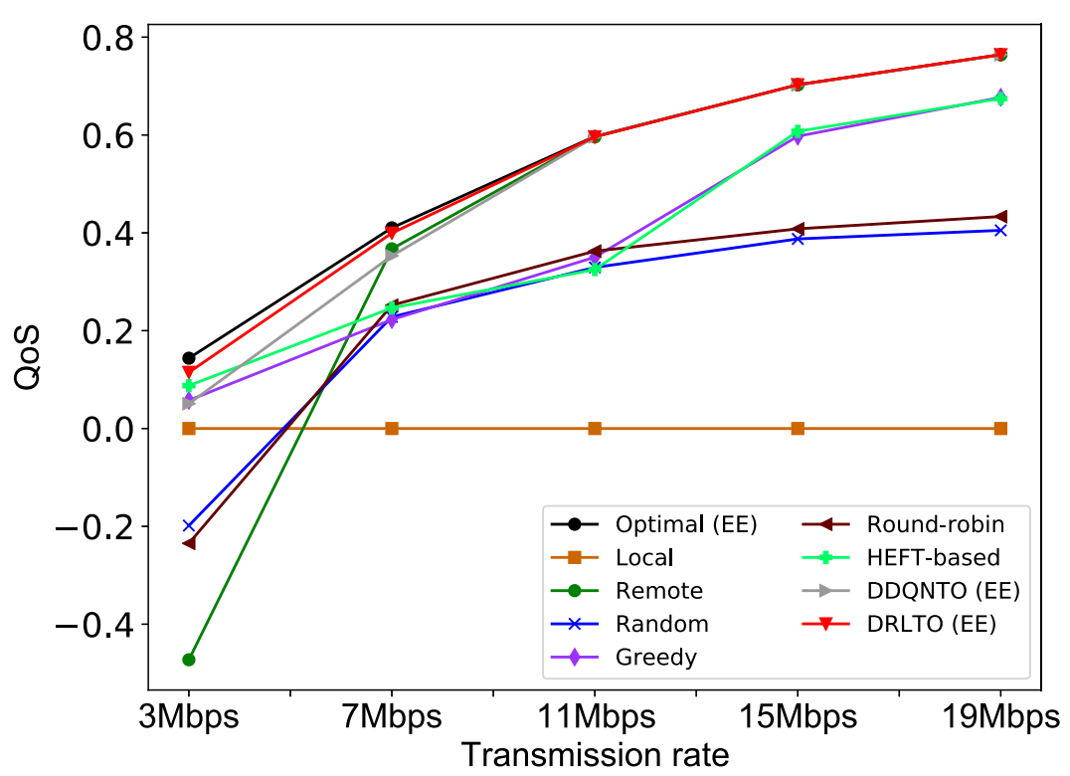
Experiments
Evalution with different Transmission Rates
Notes:
both the value loss and the policy loss approximate to zero after 500 episodes

Slide 26
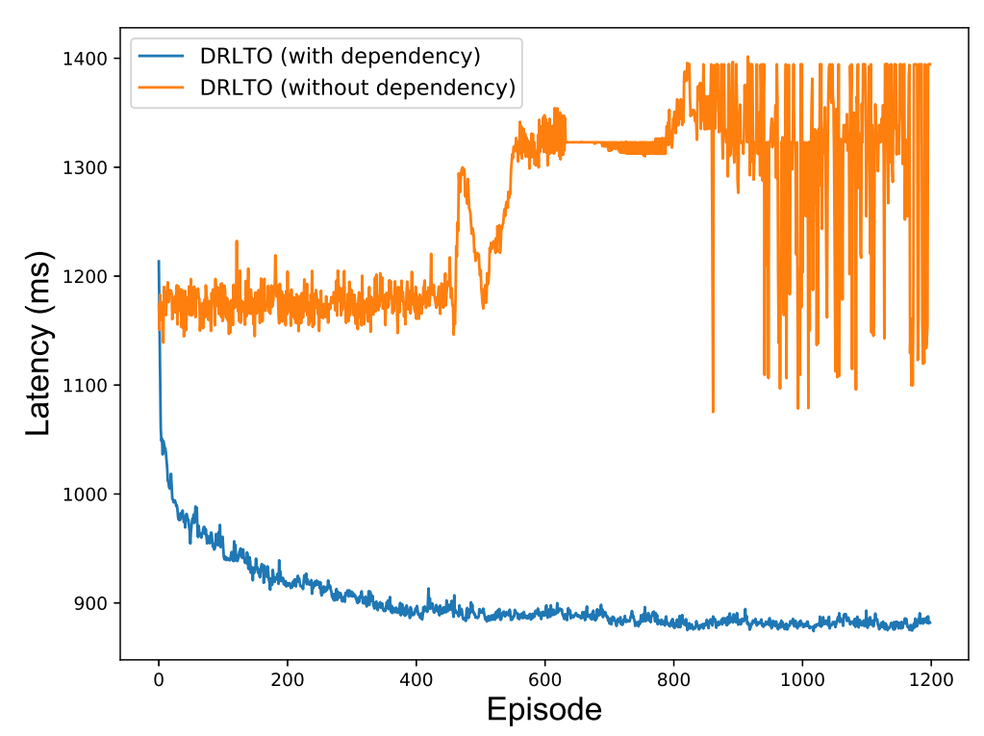
Experiments
Evalution with/without dependencies
Notes:
both the value loss and the policy loss approximate to zero after 500 episodes

Slide 27
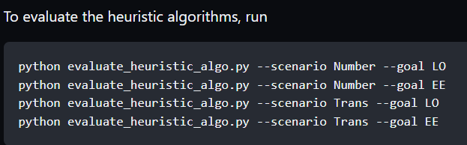
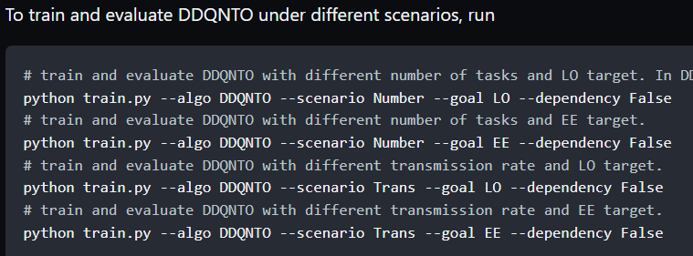
Experiments
Notes:
both the value loss and the policy loss approximate to zero after 500 episodes

Slide 28
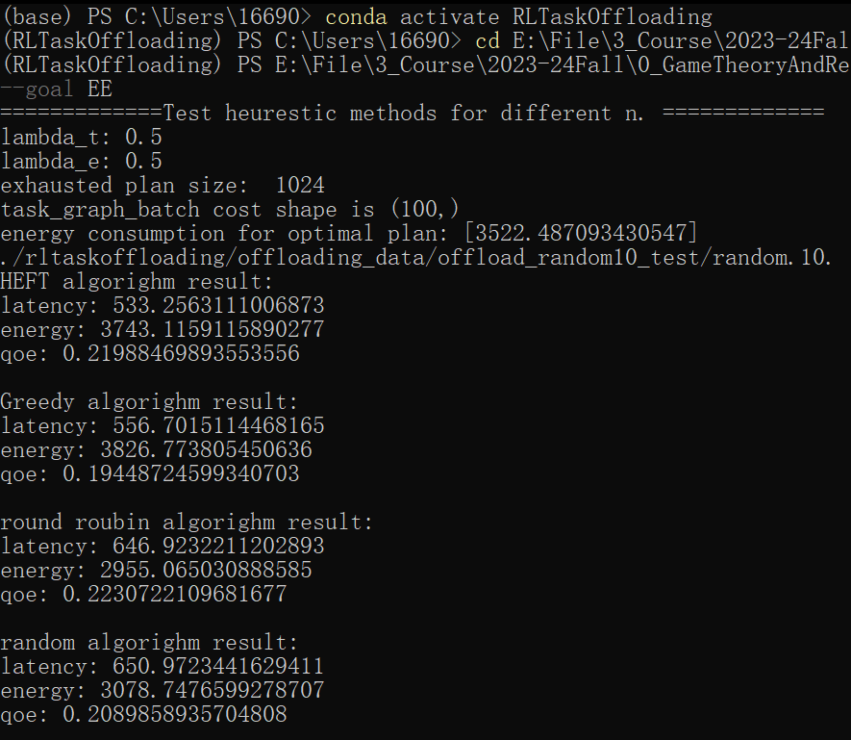
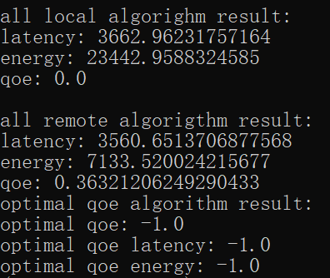
Experiments
Notes:
both the value loss and the policy loss approximate to zero after 500 episodes

Slide 29
Conclusion & Future Work
Service latency (CPU speed)
Energy consupmtion (computation & transmission cost)
MDP - S2S neural networks( trained by DRL)
Multi-agent reinforcement learning
An individual agent = one UE in the MEC
Collaborate with others
Notes:
both the value loss and the policy loss approximate to zero after 500 episodes

Slide 30
Thanks

Slide 31
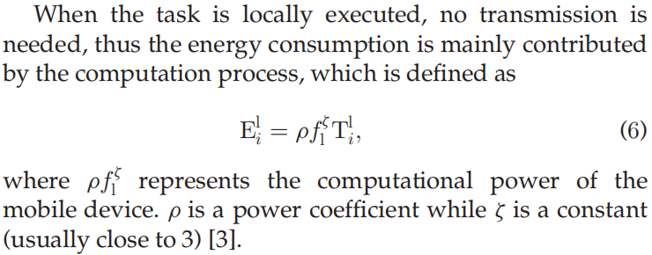
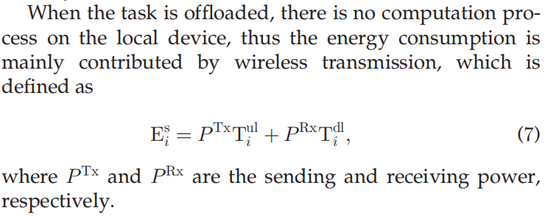
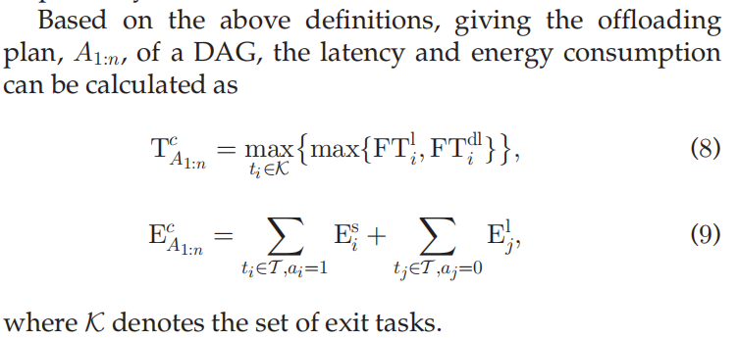
Example: AR - Modeling from current enviornment
Service latency (CPU speed)
Energy consupmtion (computation & transmission cost)
Appendix
sending & receiving

Slide 32
Example: AR - Modeling from current enviornment
Service latency (CPU speed)
Energy consupmtion (computation & transmission cost)
Appendix

